Slide 1
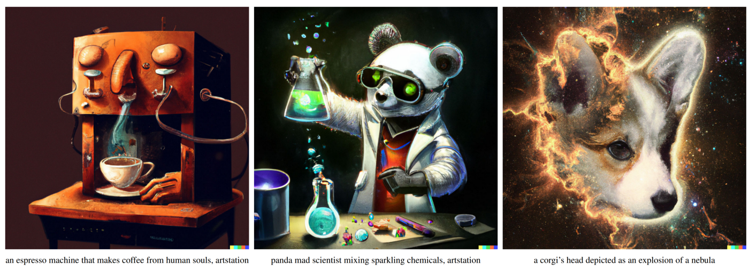
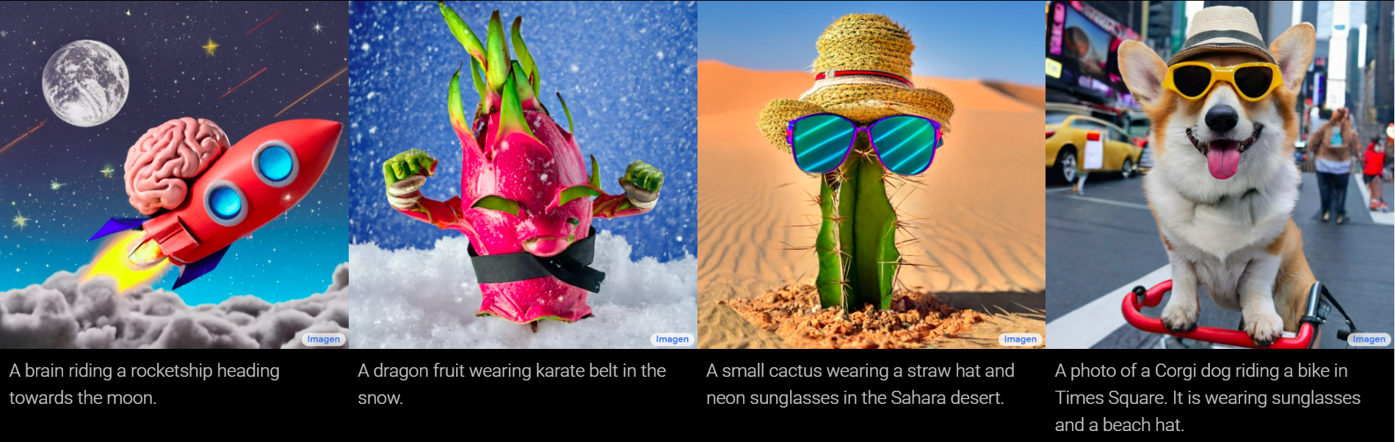
Text-to-Image Generation
DALLE-2 | OpenAI
Imagen | Google Research
Presentation by TJ LaGrow
TReNDS Center MLBBQ
6/17/2022
Ramesh, Aditya, et al. "Hierarchical text-conditional image generation with clip latents." arXiv preprint arXiv:2204.06125 (2022).
Saharia, Chitwan, et al. "Photorealistic Text-to-Image Diffusion Models with Deep Language Understanding." arXiv preprint arXiv:2205.11487 (2022)

Slide 2
Overview
Overview of DALLE-2
Overview of Imagen
Ethical Issues
Discussion

Slide 3
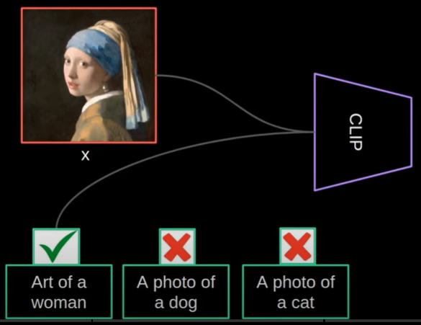
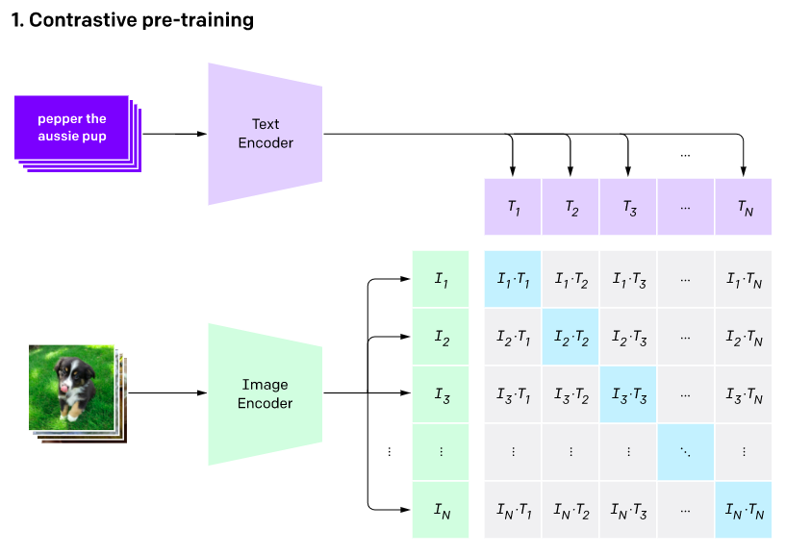
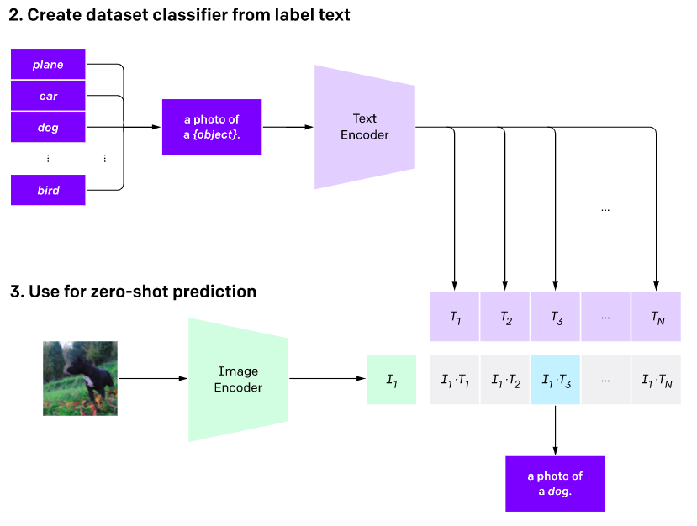
CLIP: Contrastive Language–Image Pre-training
Radford, Alec, et al. "Learning transferable visual models from natural language supervision." International Conference on Machine Learning. PMLR, 2021.
Notes:
CLIP pre-trains an image encoder and a text encoder to predict which images were paired with which texts in our dataset. We then use this behavior to turn CLIP into a zero-shot classifier. We convert all of a dataset’s classes into captions such as “a photo of a dog” and predict the class of the caption CLIP estimates best pairs with a given image.
Costly datasets: Deep learning needs a lot of data, and vision models have traditionally been trained on manually labeled datasets that are expensive to construct and only provide supervision for a limited number of predetermined visual concepts. The ImageNet dataset, one of the largest efforts in this space, required over 25,000 workers to annotate 14 million images for 22,000 object categories. In contrast, CLIP learns from text–image pairs that are already publicly available on the internet. Reducing the need for expensive large labeled datasets has been extensively studied by prior work, notably self-supervised learning,¹⁴¹⁵¹⁶ contrastive methods,¹⁷¹⁸¹⁹²⁰²¹ self-training approaches,²²²³ and generative modeling.
Narrow: An ImageNet model is good at predicting the 1000 ImageNet categories, but that’s all it can do “out of the box.” If we wish to perform any other task, an ML practitioner needs to build a new dataset, add an output head, and fine-tune the model. In contrast, CLIP can be adapted to perform a wide variety of visual classification tasks without needing additional training examples. To apply CLIP to a new task, all we need to do is “tell” CLIP’s text-encoder the names of the task’s visual concepts, and it will output a linear classifier of CLIP’s visual representations. The accuracy of this classifier is often competitive with fully supervised models.

Slide 4
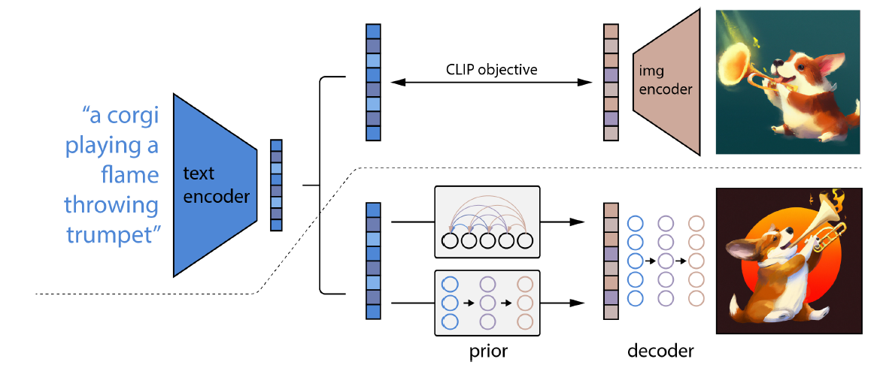
DALLE2 Architecture
Notes:
A high-level overview of unCLIP. Above the dotted line, we depict the CLIP training process,
through which we learn a joint representation space for text and images. Below the dotted line, we depict our
text-to-image generation process: a CLIP text embedding is first fed to an autoregressive or diffusion prior
to produce an image embedding, and then this embedding is used to condition a diffusion decoder which
produces a final image. Note that the CLIP model is frozen during training of the prior and decoder.

Slide 5
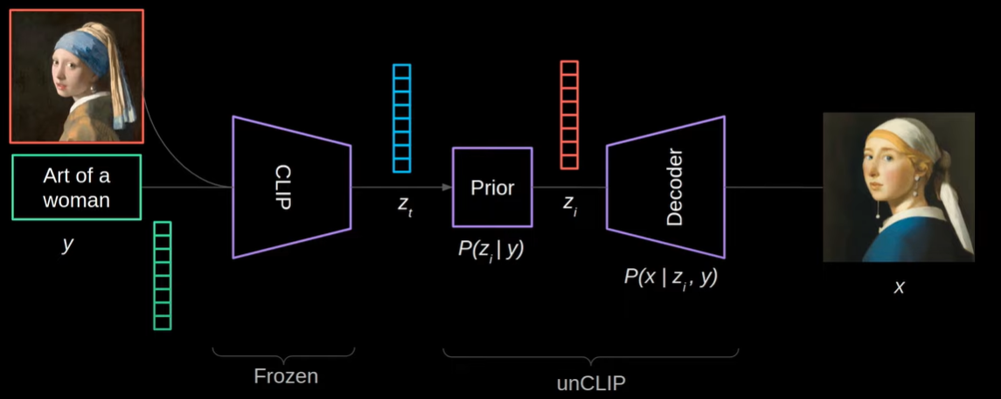
unCLIP
Notes:
=

Slide 6
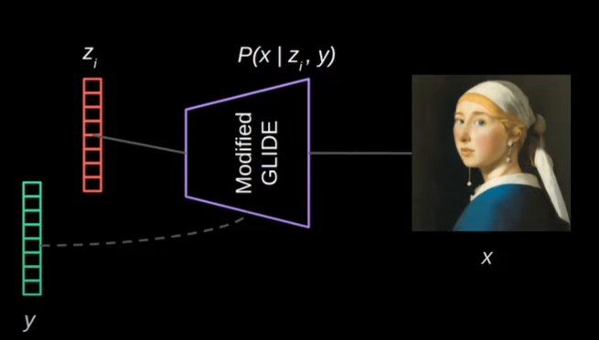
unCLIP Decoder
Modified GLIDE model to take CLIP embeddings in 4 extra tokens + GLIDE text encoder
To enable better guidance, randomly drop CLIP embeddings 10% and text captions
2 upsampling models:
64x64 -> 256x256 -> 1024x1024
Train on random crop 1 / 4 of output size
Notes:
Modified GLIDE model to take CLIP embeddings in 4 extra tokens + GLIDE text encoder
To enable better guidance, randomly drop CLIP embeddings 10% and text captions
2 upsampling models: 64x64 -> 256x256 -> 1024x1024
Train on random crop ¼ of output size

Slide 7
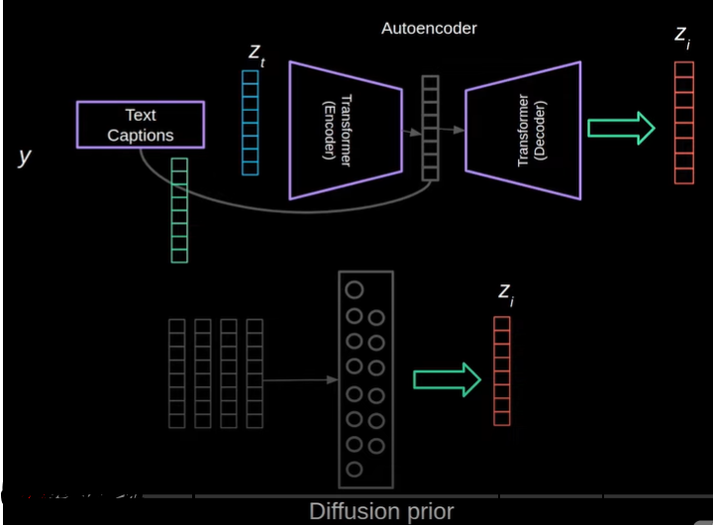
Priors
Autoregressive Prior
PCA applied to embeddings z_i and used at 319 dim for better training stability
Add text captions as prefix
Text Transformer – Encoder/Decoder (24 Blocks)
Diffusion Prior
Decoder only transformer
Combined input: encoder text + CLIP embedding + timestamp + noised z_i
Output: unnoised z_i
Generate 2 samples of z_i and use one with the best dot product with z_i
Notes:
Autoregressing Prior

Slide 8
Priors
Autoregressive Prior
PCA applied to embeddings z_i and used at 319 dim for better training stability
Add text captions as prefix
Text Transformer – Encoder/Decoder (24 Blocks)
Diffusion Prior
Decoder only transformer
Combined input: encoder text + CLIP embedding + timestamp + noised z_i
Output: unnoised z_i
Generate 2 samples of z_i and use one with the best dot product with z_i
Notes:
Autoregressing Prior

Slide 9
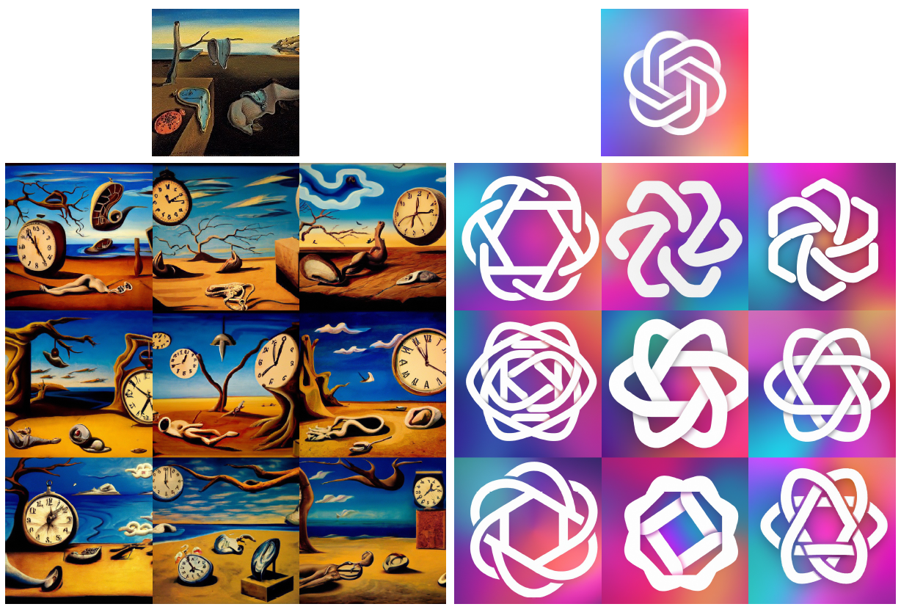
Priors
Autoregressive Prior
PCA applied to embeddings z_i and used at 319 dim for better training stability
Add text captions as prefix
Text Transformer – Encoder/Decoder (24 Blocks)
Diffusion Prior
Decoder only transformer
Combined input: encoder text + CLIP embedding + timestamp + noised z_i
Output: unnoised z_i
Generate 2 samples of z_i and use one with the best dot product with z_i
Notes:
Variations of an input image by encoding with CLIP and then decoding with a diffusion model. The
variations preserve both semantic information like presence of a clock in the painting and the overlapping
strokes in the logo, as well as stylistic elements like the surrealism in the painting and the color gradients in
the logo, while varying the non-essential details.

Slide 10
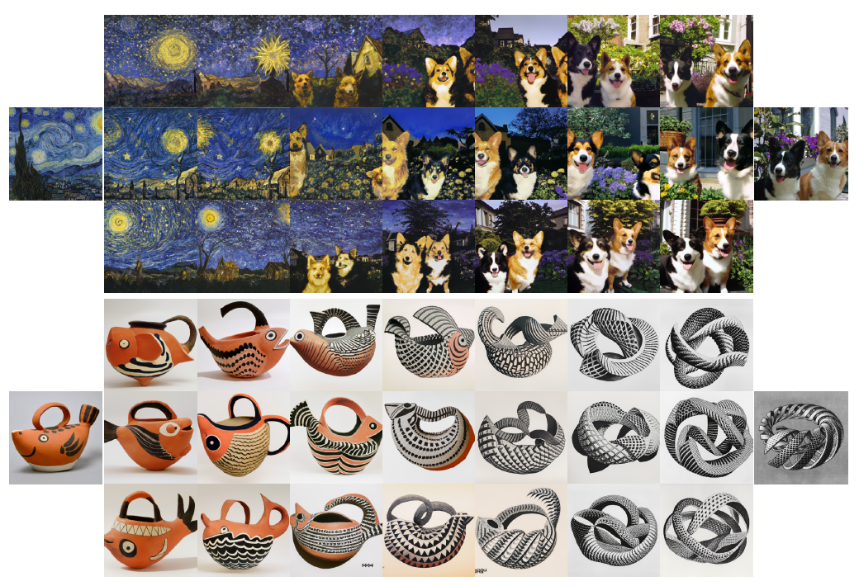
unCLIP Decoder Interpolation
Modified GLIDE model to take CLIP embeddings in 4 extra tokens + GLIDE text encoder
To enable better guidance, randomly drop CLIP embeddings 10% and text captions
2 upsampling models:
64x64 -> 256x256 -> 1024x1024
Train on random crop 1 / 4 of output size
Notes:
Variations between two images by interpolating their CLIP image embedding and then decoding
with a diffusion model. We fix the decoder seed across each row. The intermediate variations naturally blend
the content and style from both input images
Denoising Diffusion Implicit Models – arXiv
spherical interpolation

Slide 11
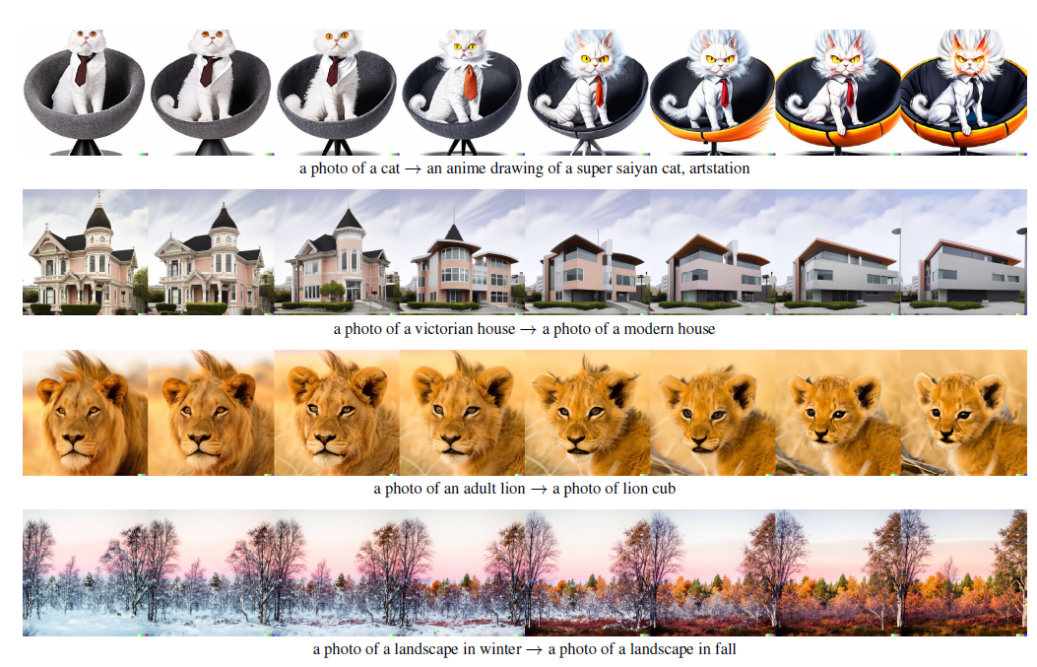
Text Diff
Notes:
Text diffs applied to images by interpolating between their CLIP image embeddings and a normalised
difference of the CLIP text embeddings produced from the two descriptions. We also perform DDIM inversion
to perfectly reconstruct the input image in the first column, and fix the decoder DDIM noise across each row.

Slide 12
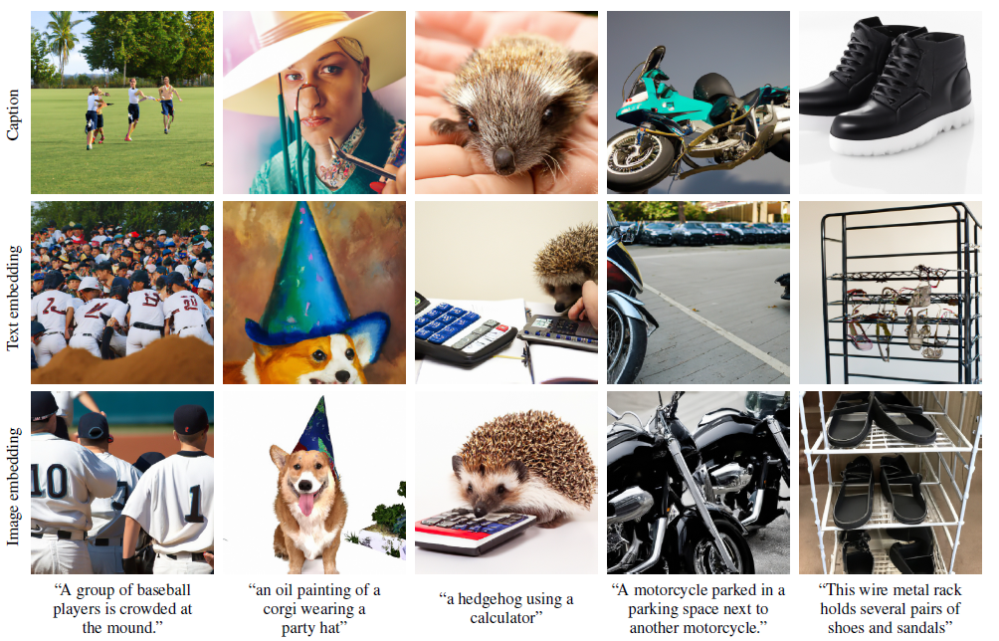
Importance of the Prior
Notes:
Samples using different conditioning signals for the same decoder. In the first row, we pass the text
caption to the decoder, and pass a zero vector for the CLIP embedding. In the second row, we pass both the
text caption and the CLIP text embedding of the caption. In the third row, we pass the text and a CLIP image
embedding generated by an autoregressive prior for the given caption. Note that this decoder is only trained
to do the text-to-image generation task (without the CLIP image representation) 5% of the time.

Slide 13
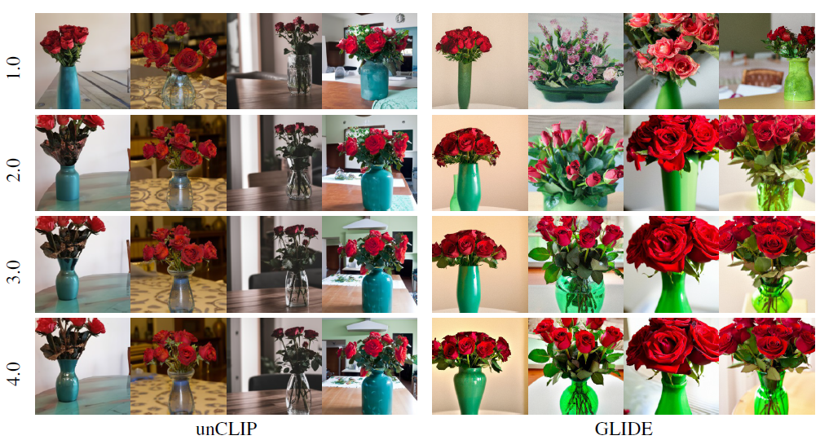
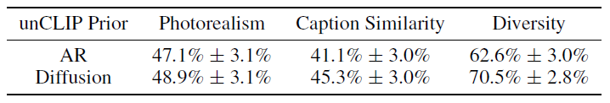
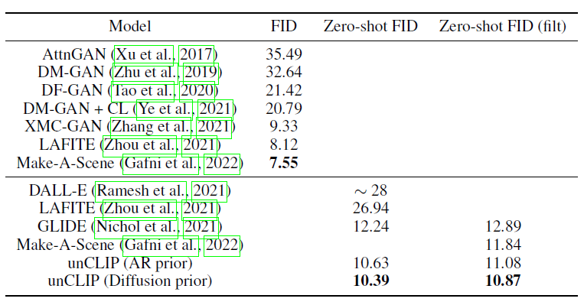
Evaluation
Notes:
For the evaluation of the performance of GANs at image generation, we introduce the “Frechet Inception Distance” (FID) which captures the similarity of generated images to real ones better than the Inception Score.
The inception score estimates the quality of a collection of synthetic images based on how well the top-performing image classification model Inception v3 classifies them as one of 1,000 known objects. The scores combine both the confidence of the conditional class predictions for each synthetic image (quality) and the integral of the marginal probability of the predicted classes (diversity).
The inception score does not capture how synthetic images compare to real images. The goal in developing the FID score was to evaluate synthetic images based on the statistics of a collection of synthetic images compared to the statistics of a collection of real images from the target domain.
Samples when increasing guidance scale for both unCLIP and GLIDE, using the prompt, “A green
vase filled with red roses sitting on top of table.” For unCLIP, we fix the latent vectors sampled from the prior,
and only vary the guidance scale of the decoder. For both models, we fix the diffusion noise seed for each
column. Samples from unCLIP improve in quality (more realistic lighting and shadows) but do not change in
content as we increase guidance scale, preserving semantic diversity even at high decoder guidance scales.
Human evaluations comparing unCLIP to GLIDE. We compare to both the AR and diffusion prior
for unCLIP. Reported figures are 95% confidence intervals of the probability that the unCLIP model specified
by the row beats GLIDE. Sampling hyperparameters for all models were swept to optimize an automated
proxy for human photorealism evaluations.
Comparison of FID on MS-COCO 256 256. We use guidance scale 1.25 for the decoder for both
the AR and diffusion prior, and achieve the best results using the diffusion prior.

Slide 14
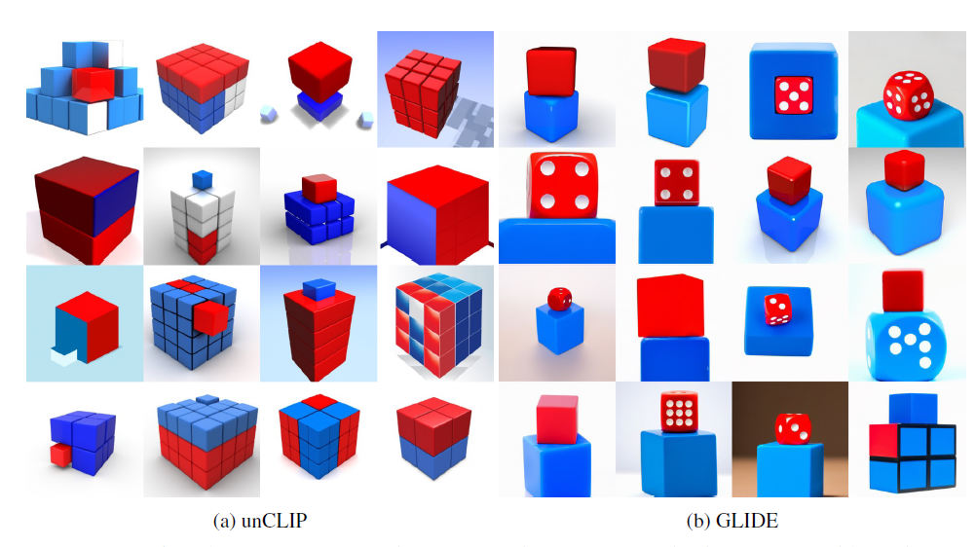
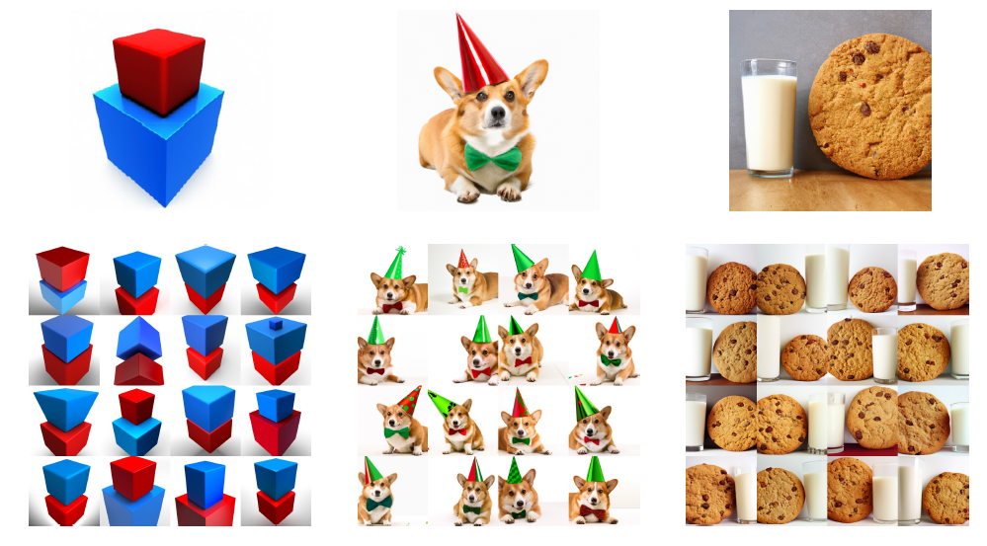
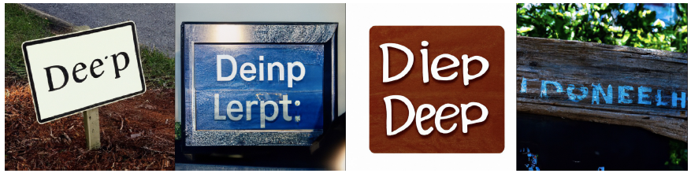
Poor Performance
Notes:
Samples from unCLIP and GLIDE for the prompt “a red cube on top of a blue cube”.
Reconstructions from the decoder for difficult binding problems. We find that the reconstructions
mix up objects and attributes. In the first two examples, the model mixes up the color of two objects. In the
rightmost example, the model does not reliably reconstruct the relative size of two objects.
Samples from unCLIP for the prompt, “A sign that says deep learning.”

Slide 15
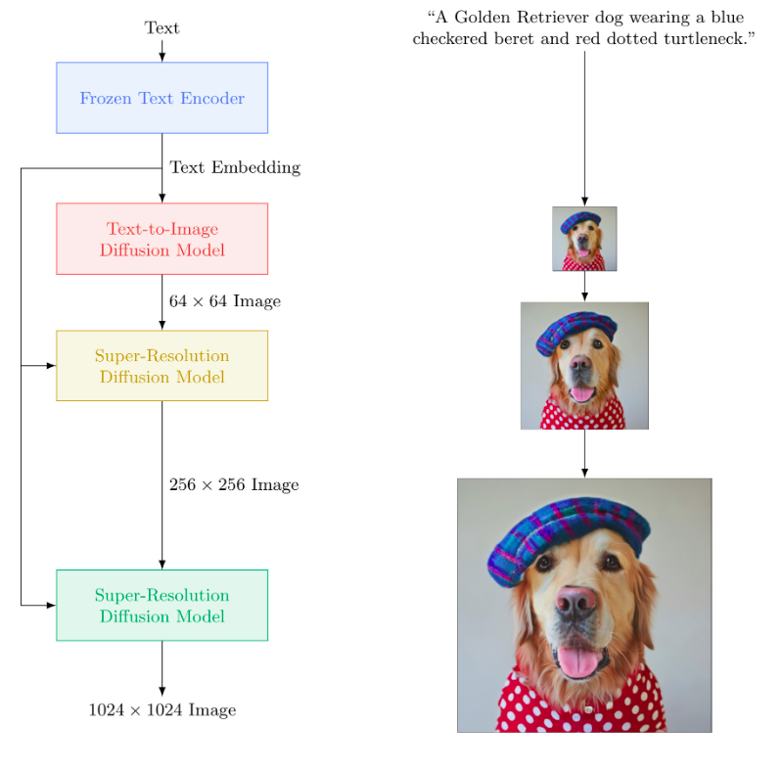
Imagen

Slide 16
Go to Imagen Paper
Talk about Ethics

Slide 17
Thank you!

